Slide 1
DATA SWAMPS:
● Data swamps are simply data lakes that are not managed.
● They are not to be feared. They need to be tamed.
● Following are four critical steps to avoid a data swamp.
1. Start with Concrete Business Questions
2. Data Quality
3. Audit and Version Management
4. Data Governance

Slide 2
1 Start with Concrete Business Questions:
● Simply dumping a horde of data into a data lake, with no tangible purpose in mind, will result in a big business risk.
● The data lake must be enabled to collect the data required to answer your business questions.
● It is suggested to perform a comprehensive analysis of the entire set of data you have and then apply a metadata classification for the data, stating full data lineage for allowing it into the data lake.

Slide 3
2. Data Quality:
● More data points do not mean that data quality is less relevant.
● Data quality can cause the invalidation of a complete data set, if not dealt with correctly.
3. Audit and Version Management:
● You must always report the following:
• Who used the process?
• When was it used?
• Which version of code was used?

Slide 4
4. Data Governance:
● The role of data governance, data access, and data security does not go away with the volume of data in the data lake.
● It simply collects into a worse problem, if not managed.
● Data Governance can be implemented in the following ways:
• Data Source Catalog
• Business Glossary
• Analytical Model Usage

Slide 5
Data Source CataLog:
● Metadata that link ingested data-to-data sources are a must-have for any data lake.
● Data processing should include the following rules:
● Unique data catalog number
• use YYYYMMDD/ NNNNNN/NNN.
• E.g. 20171230/000000001/001 for data first registered into the metadata registers on December 30, 2017, as data source 1 of data type 1.
• This is a critical requirement.
● Short description (It should be under 100 characters)
• Country codes and country names 37
• Ex. ISO 3166 defines Country Codes as per United Nations Sources

Slide 6
Long description (It should kept as complete as possible)
• Country codes and country names used by your organization as standard for country entries
● Contact information for external data source
• ISO 3166-1:2013 code lists from www.iso.org/iso-3166- country-codes.html
● Expected frequency
• Irregular i.e., no fixed frequency, also known as ad hoc, every minute, hourly, daily, weekly, monthly, or yearly.
• Other options are near-real-time, every 5 seconds, every minute, hourly, daily, weekly, monthly, or yearly.
● Internal business purpose
• Validate country codes and names.

Slide 7
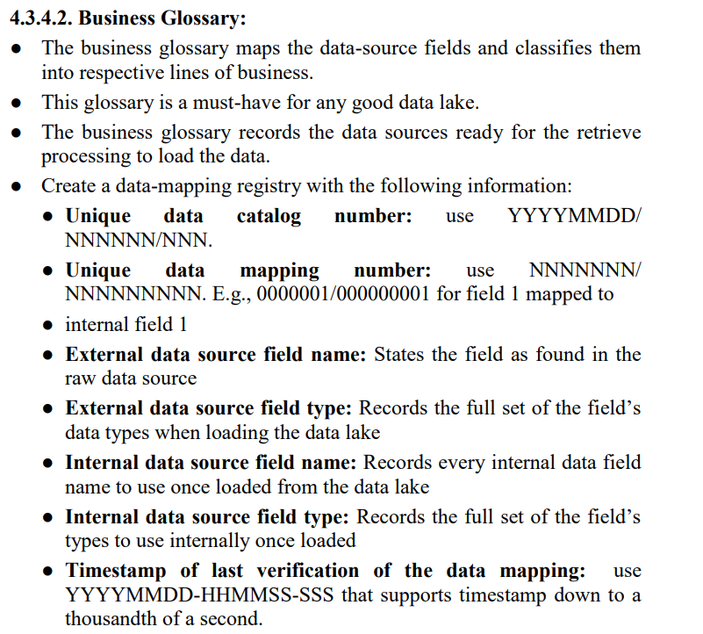

Slide 8
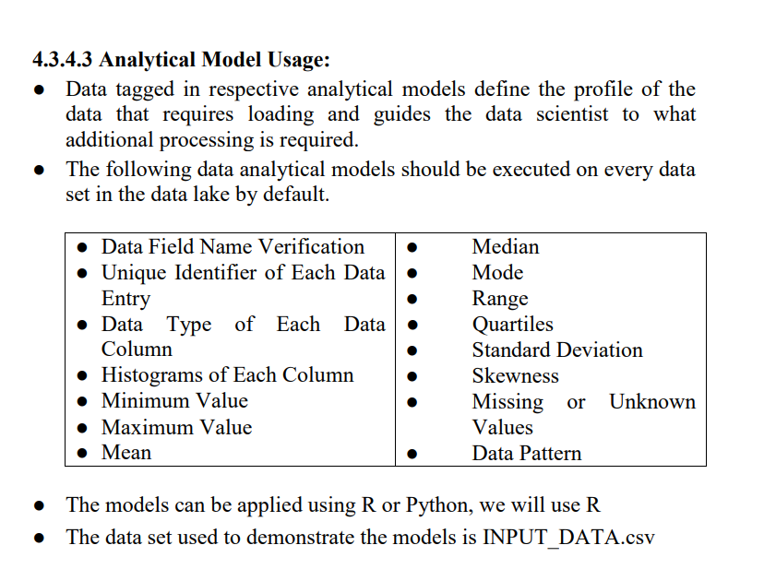

Slide 9
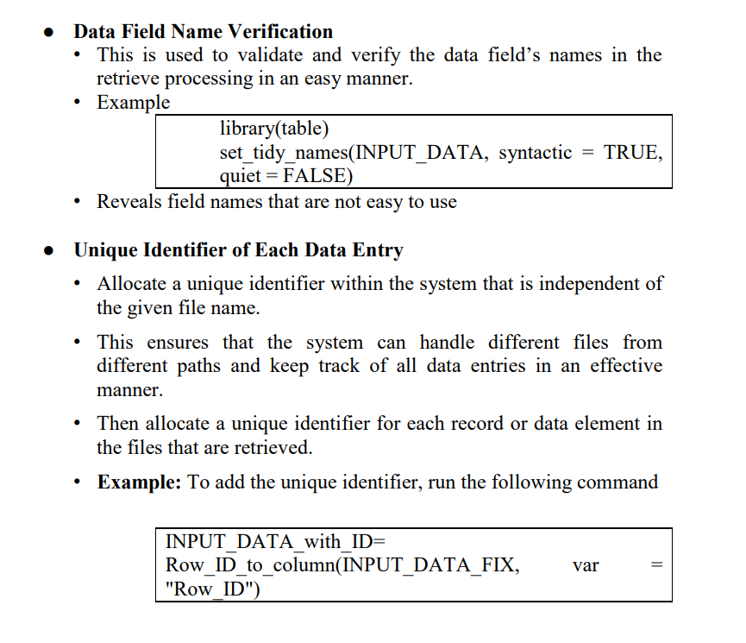

Slide 10
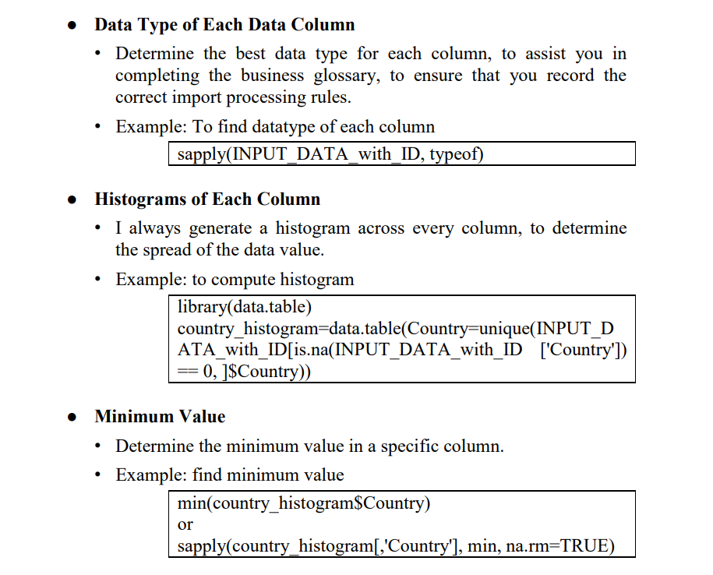

Slide 11
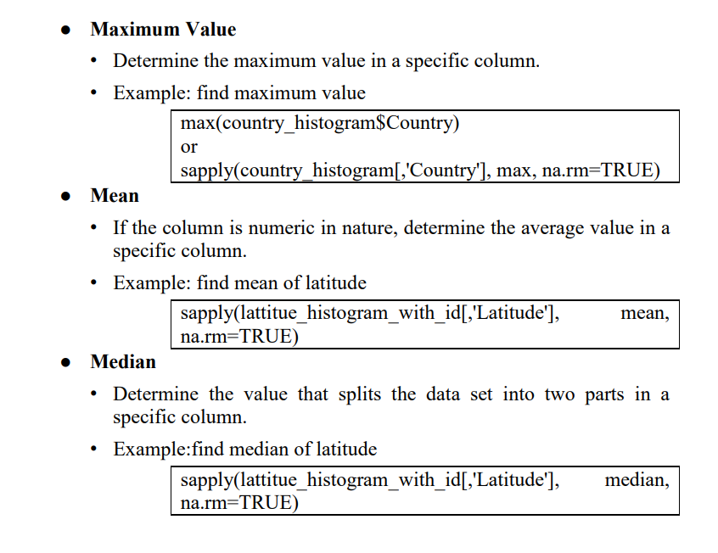

Slide 12
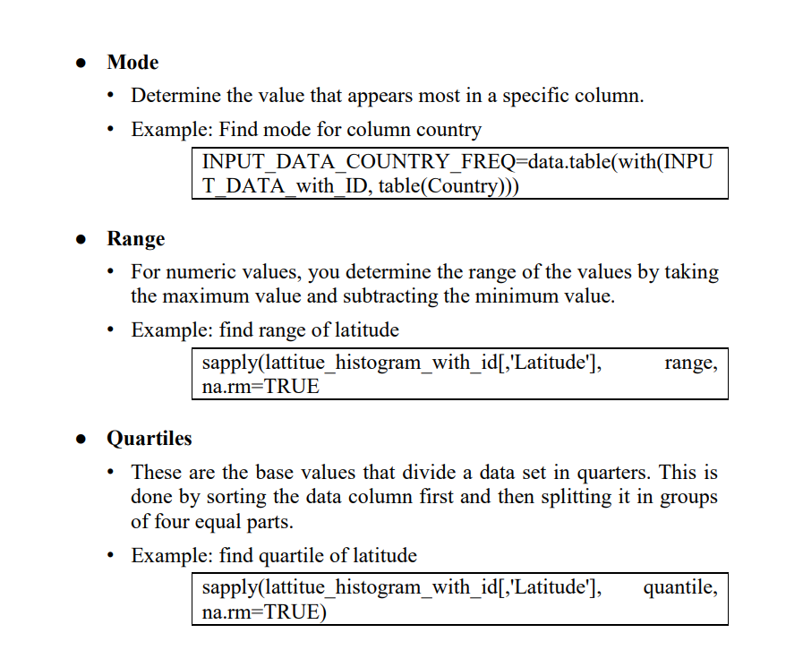

Slide 13
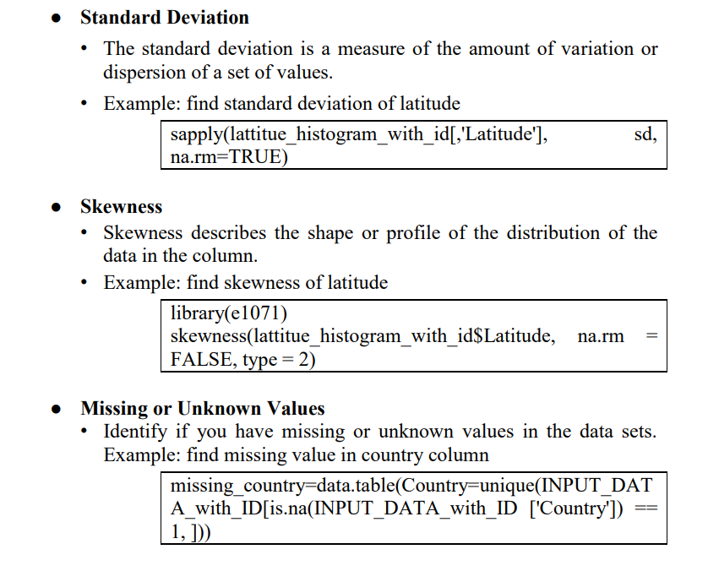

Slide 14
